Slide 1
Chapter 35
Energy and Commodity Derivatives

Slide 2
Agricultural Commodities
Corn, wheat, soybeans, cocoa, coffee, sugar, cotton, frozen orange juice, cattle, hogs, pork bellies, etc
Supply-demand measured by stocks-to-use ratio
Seasonality and mean reversion in prices (farmers have a choice about what they produce)
Weather important

Slide 3
Metals
Gold, silver, platinum, palladium, copper, tin, lead, zinc, nickel, aluminium, etc
No seasonality; weather unimportant
Investment vs consumption metals
Some mean reversion (It can become uneconomic to extract a metal)
Recycling

Slide 4
Energy Commodities
Main energy sources
  Oil
  Gas
  Electricity
All have mean reverting prices
Gas and electricity exhibit jumps

Slide 5
Crude Oil
Largest commodity market in the world
Many grades. For example
  Brent crude oil (sourced from North Sea)
  West Texas Intermediate (WTI) crude
Refined products, for example:
  Gasoline
  Heating oil
  Kerosene

Slide 6
Oil Derivatives
Virtually all derivatives available on stocks and stock indices are also available in the OTC market with oil as the underlying asset
Futures and futures options traded on the New York Mercantile Exchange (NYMEX) and the International Petroleum Exchange (IPE) are also popular

Slide 7
Natural Gas and Electricity
Deregulated
Elimination of government monopolies
Producer and supplier not necessarily the same

Slide 8
Natural Gas Derivatives
A typical OTC contract is for the delivery of a specified amount of natural gas at a roughly uniform rate to specified location during a month.
NYMEX and IPE trade contracts that require delivery of 10,000 million British thermal units of natural gas to a specified location

Slide 9
Electricity Derivatives
Electricity is an unusual commodity in that it cannot be stored
The U.S is divided into about 140 control areas and a market for electricity is created by trading between control areas.

Slide 10
Electricity Derivatives continued
A typical contract allows one side to receive a specified number of megawatt hours for a specified price at a specified location during a particular month
Types of contracts:
  5x8, 5x16, 7x24, daily or monthly exercise,
  swing options

Slide 11
Commodity Prices
Futures prices can be used to define the process followed by a commodity price in a risk-neutral world.
We can build in mean reversion and use a process for constructing trinomial trees that is analogous to that used for interest rates in Chapter 32

Slide 12
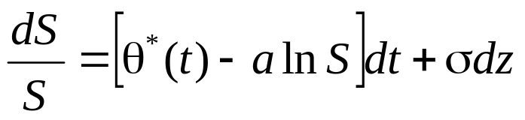
The Process for the Commodity Price
A simple mean reverting process is
d ln(S) = [θ(t) − aln(S)] dt + σ dz
Can also be written
Assume a = 0.1, σ = 0.2, and Δt = 1 year

Slide 13
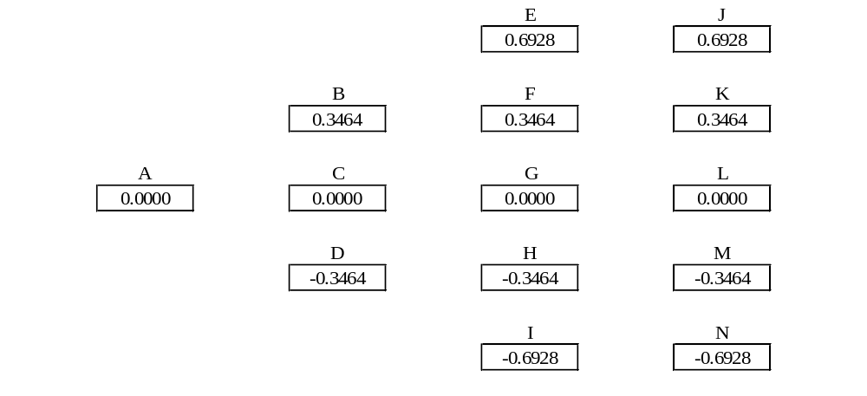
Tree for ln(S) Assuming θ(t)=0 (Figure 35.1)
Node | A | B | C | D | E | F | G | H | I
p_{u} | 0.1667 | 0.1217 | 0.1667 | 0.2217 | 0.8867 | 0.1217 | 0.1667 | 0.2217 | 0.0867
p_{m} | 0.6666 | 0.6566 | 0.6666 | 0.6566 | 0.0266 | 0.6566 | 0.6666 | 0.6566 | 0.0266
p_{d} | 0.1667 | 0.2217 | 0.1667 | 0.1217 | 0.0867 | 0.2217 | 0.1667 | 0.1217 | 0.8867

Slide 14
Determining θ(t)
The nodes on the tree are moved so that the expected commodity price equals the futures price
Assume that the one-year, two-year and three-years futures price for the commodity are $22, $23, and $24, respectively

Slide 15
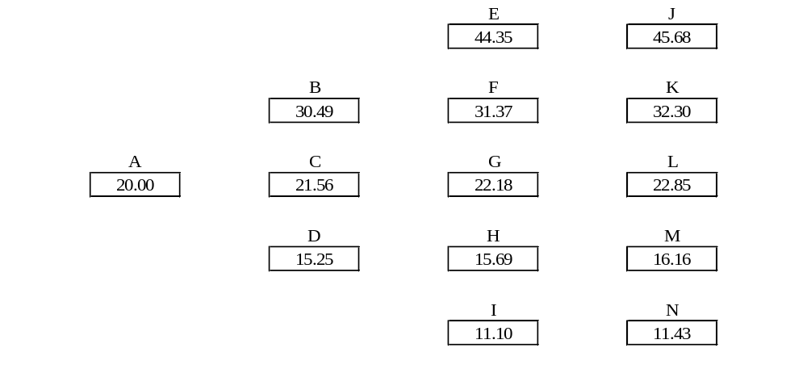
Final Tree (Figure 35.2)
Node | A | B | C | D | E | F | G | H | I
p_{u} | 0.1667 | 0.1217 | 0.1667 | 0.2217 | 0.8867 | 0.1217 | 0.1667 | 0.2217 | 0.0867
p_{m} | 0.6666 | 0.6566 | 0.6666 | 0.6566 | 0.0266 | 0.6566 | 0.6666 | 0.6566 | 0.0266
p_{d} | 0.1667 | 0.2217 | 0.1667 | 0.1217 | 0.0867 | 0.2217 | 0.1667 | 0.1217 | 0.8867

Slide 16
Interpolation and Seasonality
A simple approach
  Use a 12 month moving average of spot prices to determine a percentage seasonality factor for each month
  De-seasonalize the futures prices that are known
  Interpolate to determine other de-seasonalized futures prices
  Re-seasonalize all futures prices and construct tree

Slide 17
Jumps
Some commodity prices such as gas and electricity exhibit jumps
A process that can be assumed is then
where dp is a Poisson process generating jumps
If Poisson process is known we can use tree to model process without jumps and thereby determine θ(t)
Can be implemented with Monte Carlo simulation

Slide 18
Other Models
Convenience yield follows a mean reverting process (Gibson and Schwartz)
Volatility stochastic (Eydeland and Geman)
Reversion level stochastic (Geman)

Slide 19
Weather Derivatives (Section 35.5))
Heating degree days (HDD): For each day this is max(0, 65 – A) where A is the average of the highest and lowest temperature in ºF.
Cooling Degree Days (CDD): For each day this is max(0, A – 65)
Contracts specify the weather station to be used

Slide 20
Weather Derivatives: Products
A typical product is a forward contract or an option on the cumulative CDD or HDD during a month
Weather derivatives are often used by energy companies to hedge the volume of energy required for heating or cooling during a particular month
How would you value an option on August CDD at a particular weather station?

Slide 21
How an Energy Producer Hedges Risks (Section 35.8)
Estimate a relationship of the form
Y=a+bP+cT+ε
where Y is the monthly profit, P is the average energy prices, T is temperature, and ε is an error term
Take a position of –b in energy forwards and –c in weather forwards.

Slide 22
Insurance Derivatives (Section 35.6)
CAT bonds are an alternative to traditional reinsurance
This is a bond issued by a subsidiary of an insurance company that pays a higher-than-normal interest rate.
If claims of a certain type are in a certain range, the interest and possibly the principal on the bond are used to meet claims

Slide 23
Pricing Issues (Section 35.7)
To a good approximation many underlying variables in insurance, weather, and energy derivatives contracts can be assumed to have zero systematic risk.
This means that we can calculate expected payoff in the real world and discount at the risk-free rate

